Slide 1
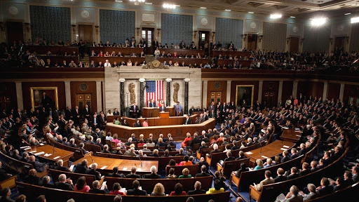
Civics Literacy Program:
Overview of the Legislative Branch

Slide 2
Civics Literacy Program:
Overview of the Legislative Branch
COURSE LEARNING OBJECTIVES :
Students will have a better understanding of how the government of the United States is structured; how it works, and their roles and responsibilities within it.
LESSON LEARNING OBJECTIVES:
4.3.1 How is the Legislative Branch structured?
4.3.2 What are the qualifications for office in Congress?
4.3.3 What are the methods of election to and terms of office in Congress?
4.3.4 What are the key positions within the Congress and who currently hold them?

Slide 3
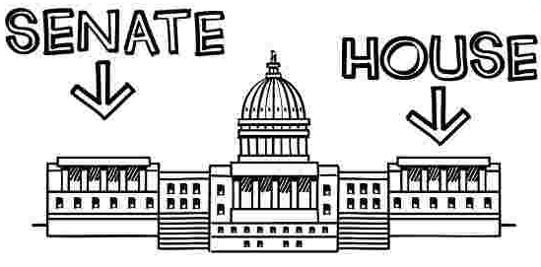
How is the Legislative Branch structured?
The Constitution establishes a bicameral legislature (one made of two houses): The House of Representatives and The Senate
Each of these bodies/chambers has its own powers and responsibilities with key leaders and role players
Each chamber also has its own qualifications for members; methods of elections; and terms of service

Slide 4
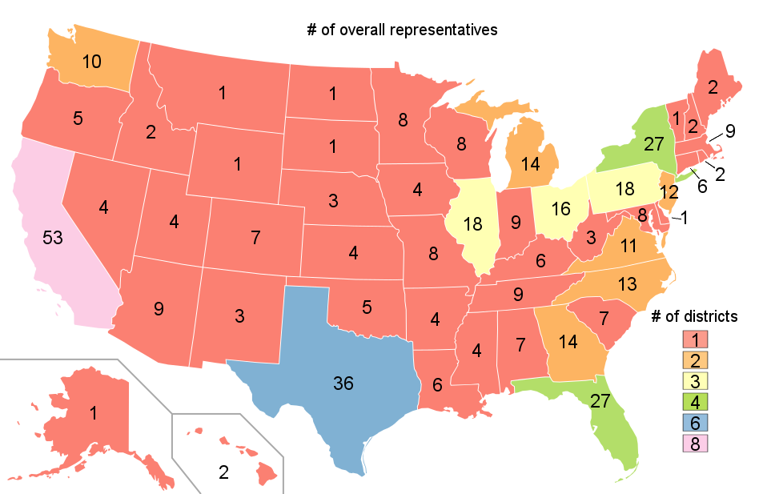
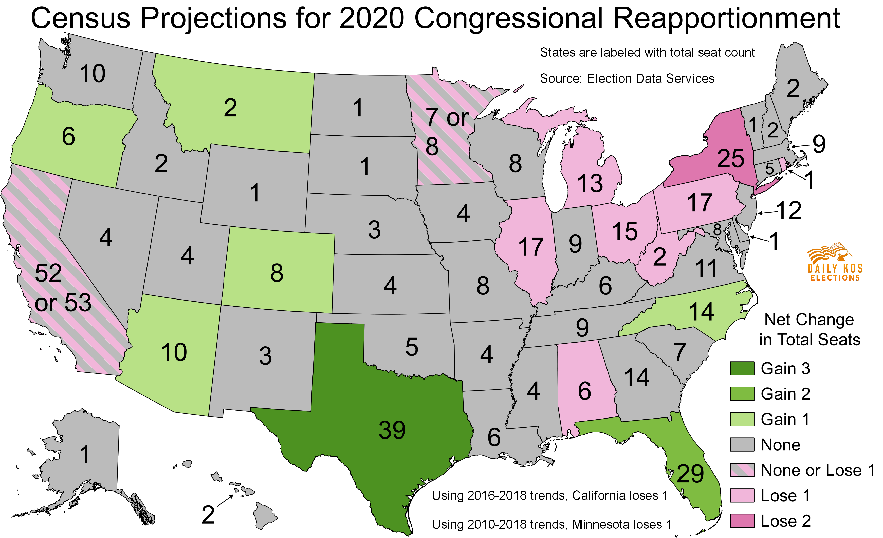
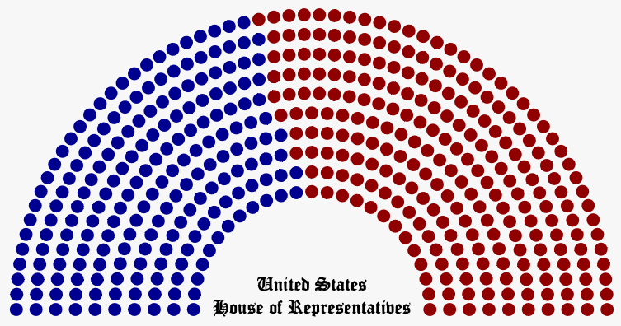
The House of Representatives
The House of Representatives has 435 members
The number of seats is apportioned (distributed) among the states on the basis of their respective populations.
These seats are reapportioned (redistributed) every ten years following the last census. ***Last census was in 2020; reapportionment was completed at state level in 2021 state legislative sessions. California, Illinois, Michigan, New York, Ohio, Pennsylvania, and West Virginia lost 1 seat each while Colorado, Florida, Montana, North Carolina, and Oregon gained 1 seat and Texas gained 2

Slide 5
The House of Representatives
The qualifications to hold office in the House of Representatives include:
must be at least 25 years of age
must have been a citizen of the United States for at least seven years
must be an inhabitant of the State from which he/she is elected
Term of service is two years with Congressional elections held every even number year on the same day (first Tuesday in November) with all 435 seats up for grabs.

Slide 6
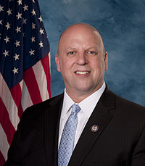
The House of Representatives
Each member of the House of Representatives (formally called Congressman or Congresswoman) is elected to represent one of the several Congressional districts within a State’s borders.
(your state) currently has (#) congressional districts.
(your town/city) is in the (#) Congressional District currently held by (Name of current Representative)

Slide 7
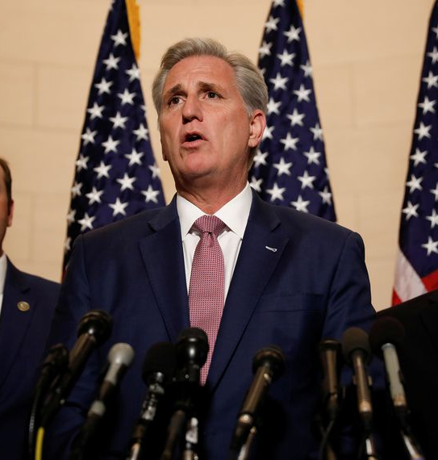
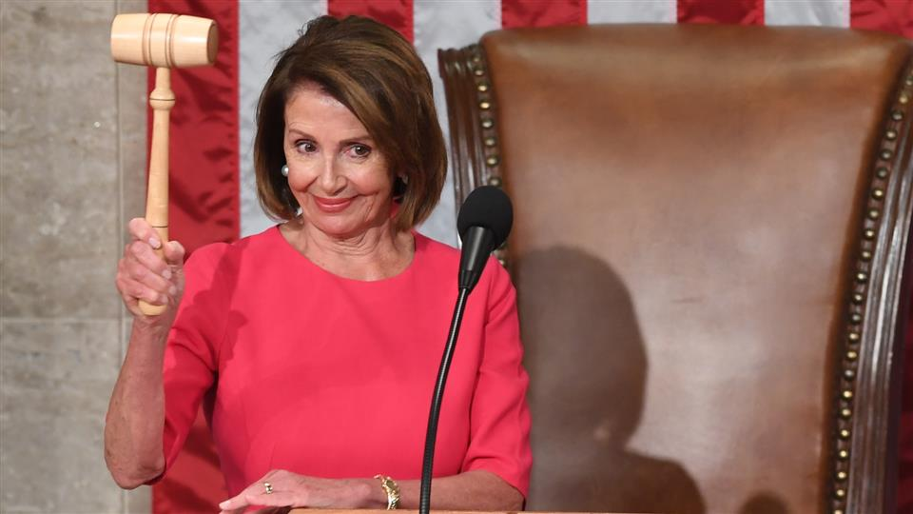
The House of Representatives
The House of Representatives has two key leadership positions that play an important role in the day-to-day business in the House and the US government in general:
The Speaker of the House: elected (by fellow members); presiding officer of the House and the leader of the majority party. Also, third in the line of secession to the Presidency. Currently held by (Current Speaker)
The Minority Leader: Elected leader and spokesman for the minority party. Currently held by (Current Minority Leader)

Slide 8
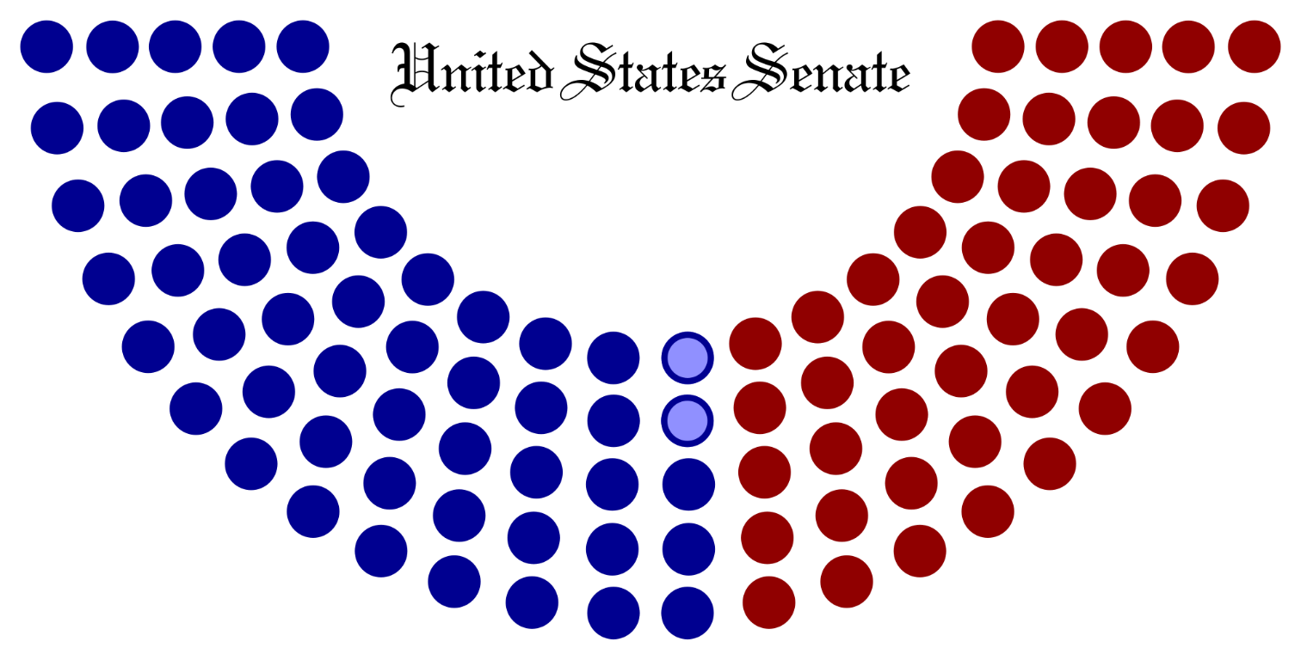
The US Senate
The United States Senate has 100 members (two per state)
The qualifications to hold office in the US Senate include:
must be at least 30 years of age
must have been a citizen of the United States for at least nine years
must be an inhabitant of the State from which he/she is elected
The term of service is six years with 1/3rd of US Senate seats up for election every two years on the same day.

Slide 9
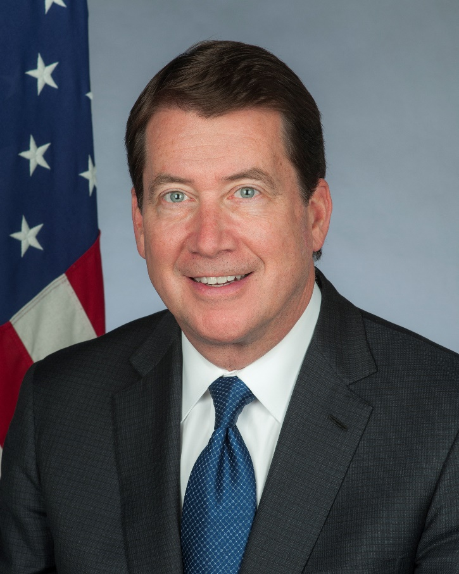
The US Senate
Each member of the US Senate (formally called Senator) is elected to represent the entire State from which they are elected
(your state)’s two current Senators are:
(name of Senior Senator) (elected in 2018; seat up for reelection in 2024)
(name of Junior Senator) (elected in 2020; seat up for reelection in 2026)

Slide 10
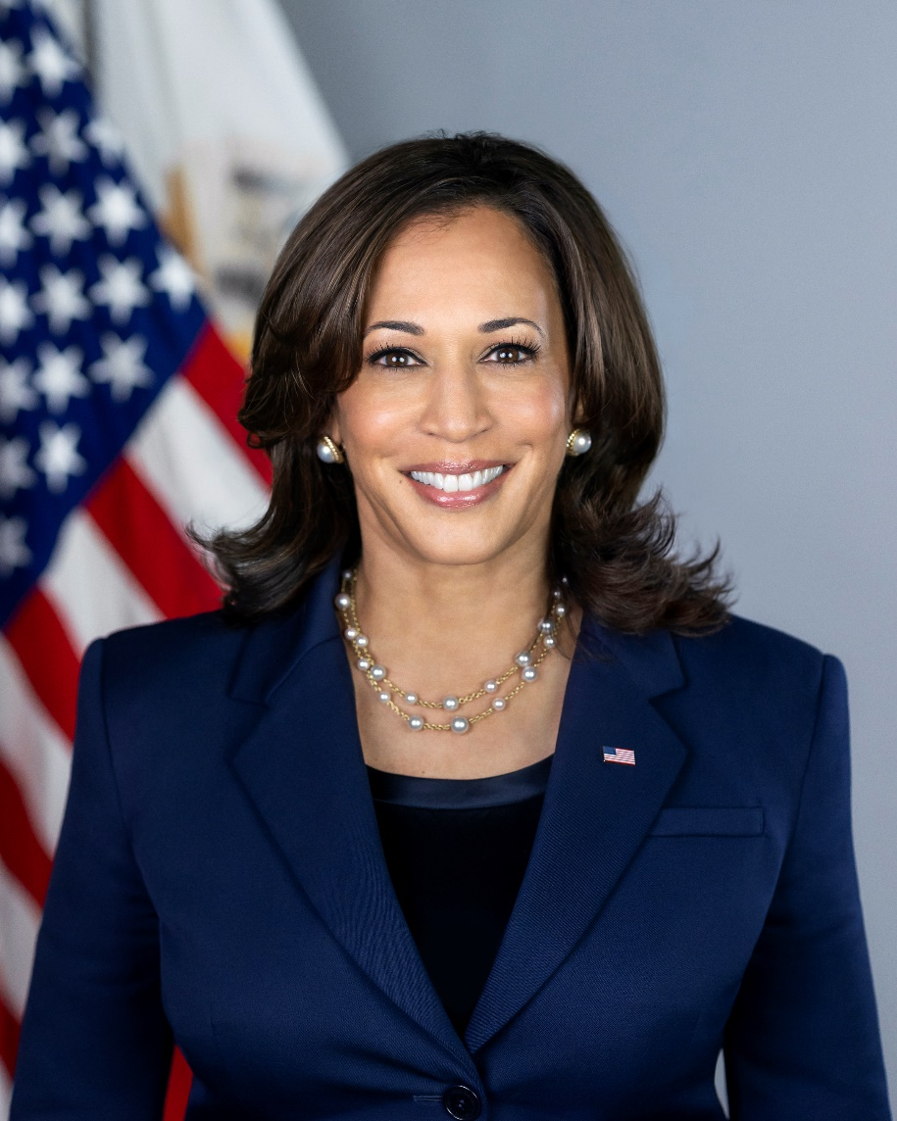
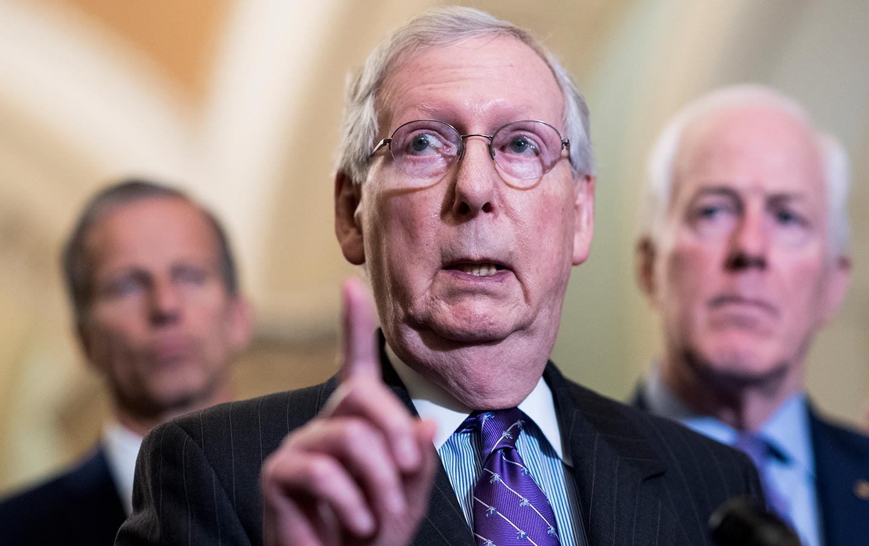
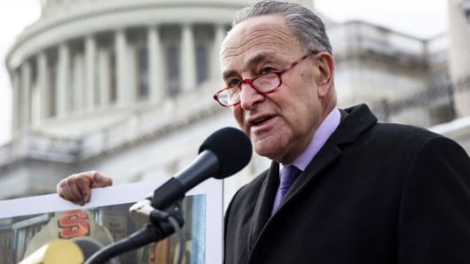
The US Senate
The US Senate has three key leadership positions that play an important role in the day-to-day business in the Senate and the US government in general:
The President of the Senate: Constitutionally filled by the Vice President of the United States. Non-voting member unless there is a tie. (Kamala Harris D)
Majority Leader: Chief spokesman and leader of the majority party (Current Majority Leader)
Minority Leader: Chief spokesman and leader of the minority party (Current Minority Leader)

Slide 11
Civics Literacy Program:
Overview of the Legislative Branch
COURSE LEARNING OBJECTIVES :
Students will have a better understanding of how the government of the United States is structured; how it works, and their roles and responsibilities within it.
FOCUS QUESTIONS:
4.3.1 How is the Legislative Branch structured?
4.3.2 What are the qualifications for office in Congress?
4.3.3 What are the methods of election to and terms of office in Congress?
4.3.4 What are the key positions within the Congress and who currently hold them?

